Slide 1

Stack Overflow Developer Survey 2020
Group 6-
Monisha Gopal, Pratik DeshMukh,
Miloni Gada, Kirtana Kirtivasan,
Moumi Kumar

Slide 2
Overview
With nearly 65,000 responses fielded from over 180 countries and dependent territories, this dataset is from a 2020 Annual Developer Survey from Stack Overflow which examines all aspects of the developer experience from career satisfaction and job search to education and opinions on open-source software.
The data set contains one row for every developer's response who took the survey and several columns are explained ahead.

Slide 3
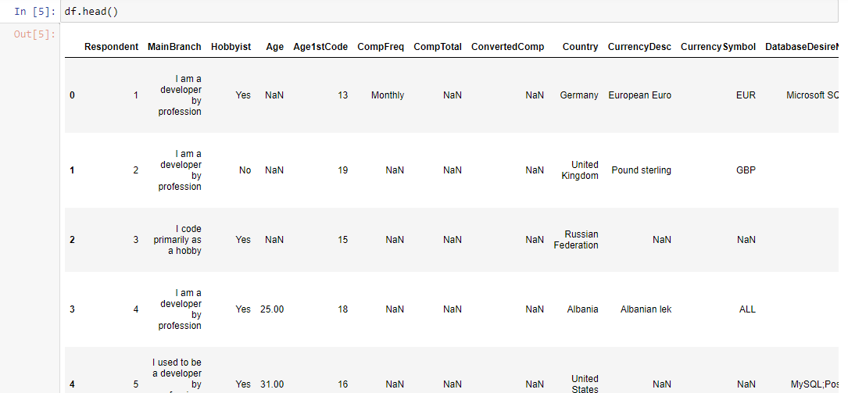
Raw Data Set

Slide 4

Data Set Shape

Slide 5
Important Columns
MainBranch: Different types of Developers – Professional, Part-time, Student Developer etc.
Age: Age of developer
Age1stCode: Age at which a person writes the first line of code or program
ConvertedComp: Salary converted to annual USD salaries using the exchange rate on 2020-02-19, assuming 12 working months and 50 working weeks
EdLevel: Highest level of formal education completed
Gender: Male/Female/Non-binary/Non-Conforming/Gender-Queer etc.
JobFactors: Factors to decide between two jobs that offer the same compensation, benefits, and location

Slide 6
Important Columns
JobSat: Job satisfaction for current job
NEWOnboardGood: Determine whether the company has a good onboarding process? (By onboarding, we mean the structured process of getting you settled in to your new role at a company)
OrgSize: Approximate number of people employed by the company
WorkWeekHrs: Average number of hours per week that a person works for

Slide 7
Data Cleaning – Techniques used
1. Dropped irrelevant columns
2. Replaced long description with shorter meaningful words in the data
3. Replaced 'Yes' and 'No' with 1s and 0s, respectively
4. Used get_dummies
5. Renamed dummy columns to make them more concise and meaningful
6. Assigned numeric values to string data using df.loc
7. Renamed other columns with better titles

Slide 8
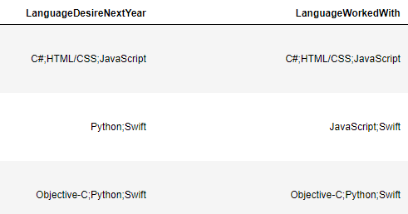
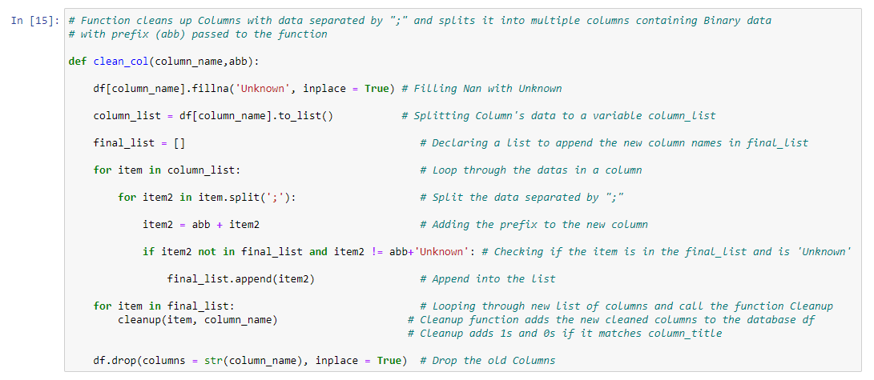
Data Cleaning – Techniques used
4. Two functions to Clean Columns with each row containing multiple values separated by " ; “

Slide 9

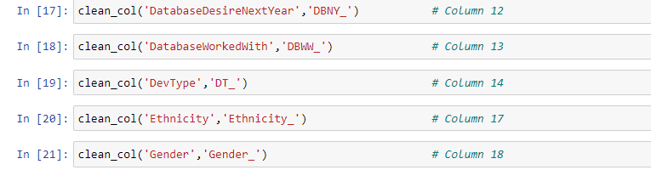
Data Cleaning – Techniques used

Slide 10


Data Set Shape after Primary Clean-up
The Data set after cleaning increased from 61 to 361 columns
The Data set after aggregating decreased from 361 to 170 columns

Slide 11
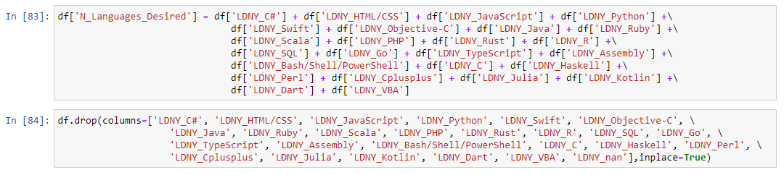
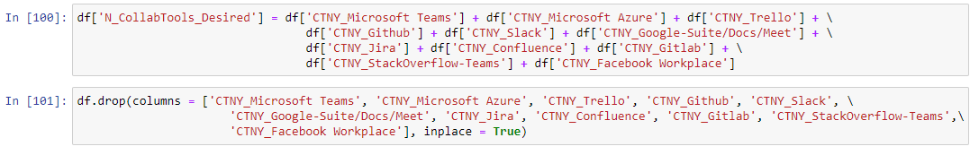
Aggregation

Slide 12
Dealing with NaN
1. Dropped columns with more than 50% of threshold values
2. Dropped rows with Nans for columns with very few Nans
3. Replacing Nans in Age and Annual Pay columns with Average values
4. Replaced Nans in other columns with value 0
5. Replaced Nans in MainBranch Column with ‘Unknown’

Slide 13
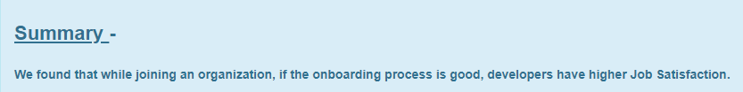
Finding 1: What are the key factors determining the highest Job Satisfaction level?

Slide 14
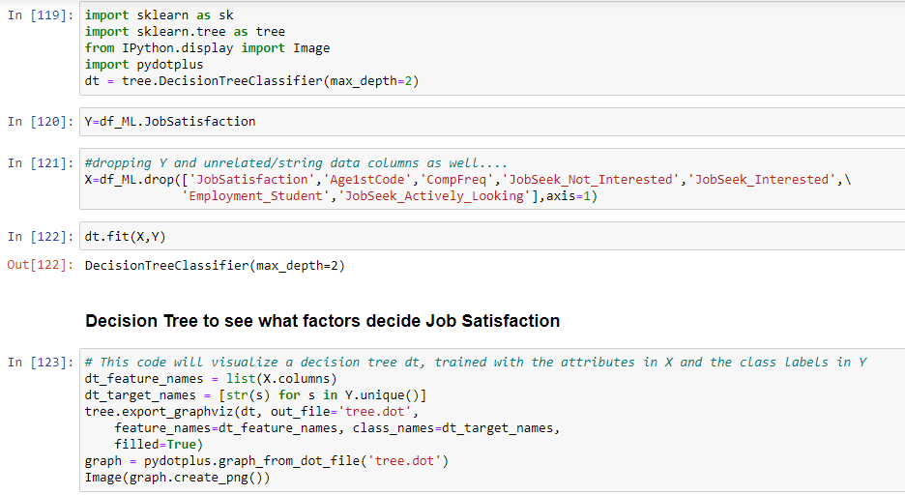
Finding 1: What are the key factors determining the highest Job Satisfaction level?

Slide 15
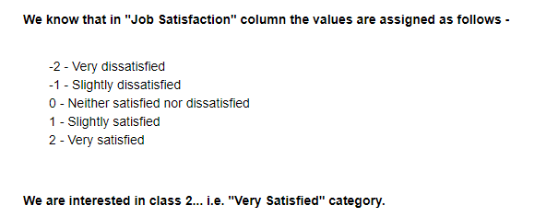
Finding 1: What are the key factors determining the highest Job Satisfaction level?

Slide 16
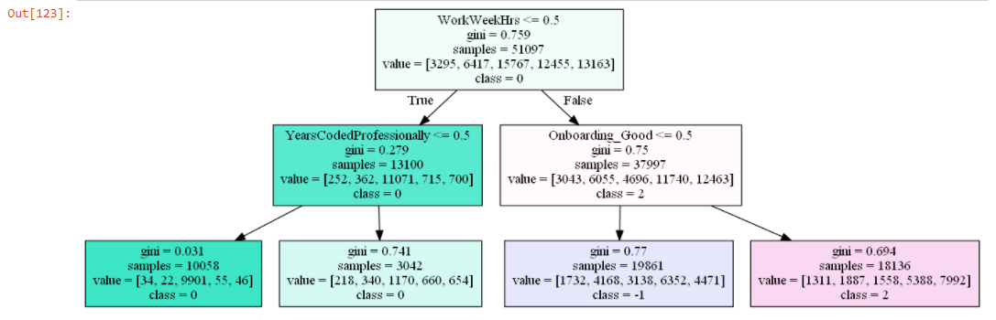
Finding 1: What are the key factors determining the highest Job Satisfaction level?

Slide 17
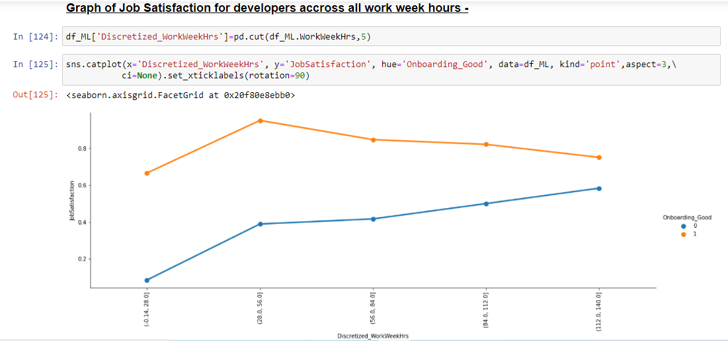
Finding 1: What are the key factors determining the highest Job Satisfaction level?

Slide 18

Finding 1: What are the key factors determining the highest Job Satisfaction level?

Slide 19
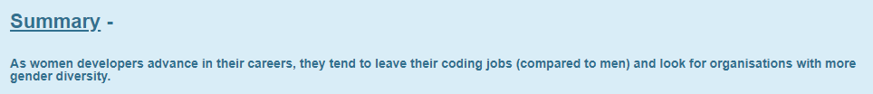
Finding 2: Women leave coding jobs earlier than men. They consider different factors when choosing between two new job opportunities.

Slide 20
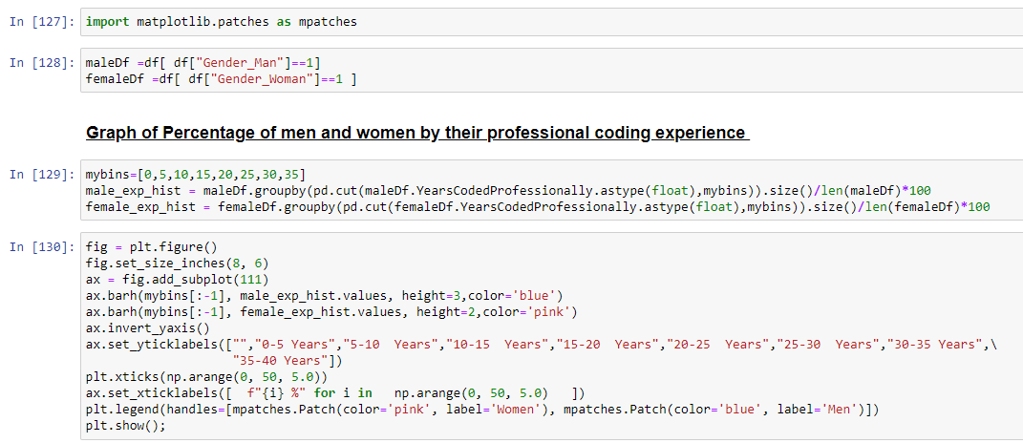
Finding 2: Women leave coding jobs earlier than men. They consider different factors when choosing between two new job opportunities.

Slide 21
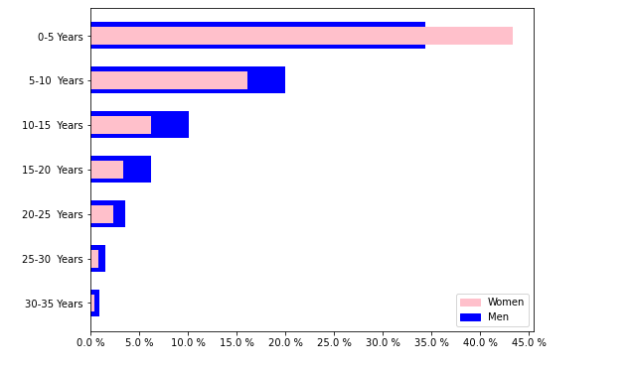
Finding 2: Women leave coding jobs earlier than men. They consider different factors when choosing between two new job opportunities.

Slide 22
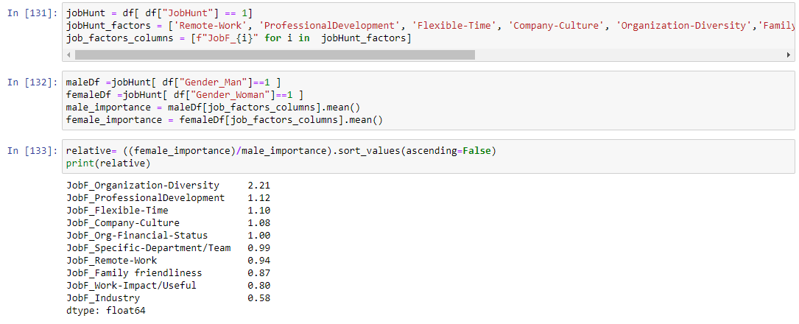
Finding 2: Women leave coding jobs earlier than men. They consider different factors when choosing between two new job opportunities.

Slide 23
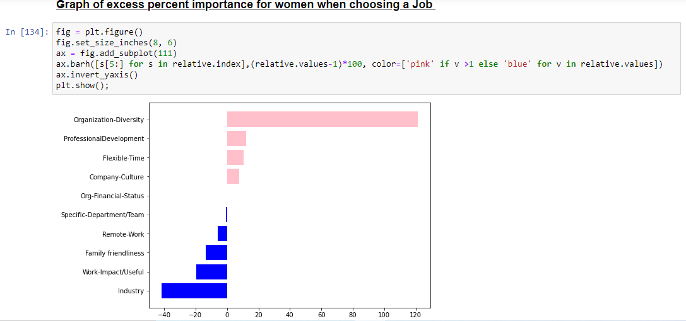
Finding 2: Women leave coding jobs earlier than men. They consider different factors when choosing between two new job opportunities.

Slide 24
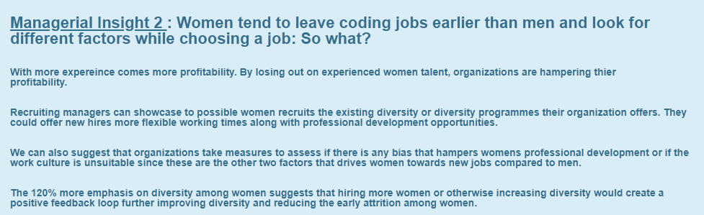
Finding 2: Women leave coding jobs earlier than men. They consider different factors when choosing between two new job opportunities.

Slide 25
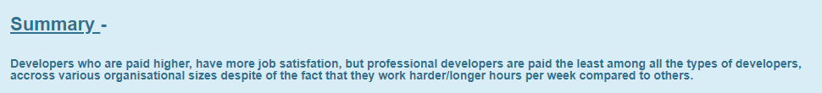
Finding 3 : The need for Better Compensation for Professional Developers

Slide 26
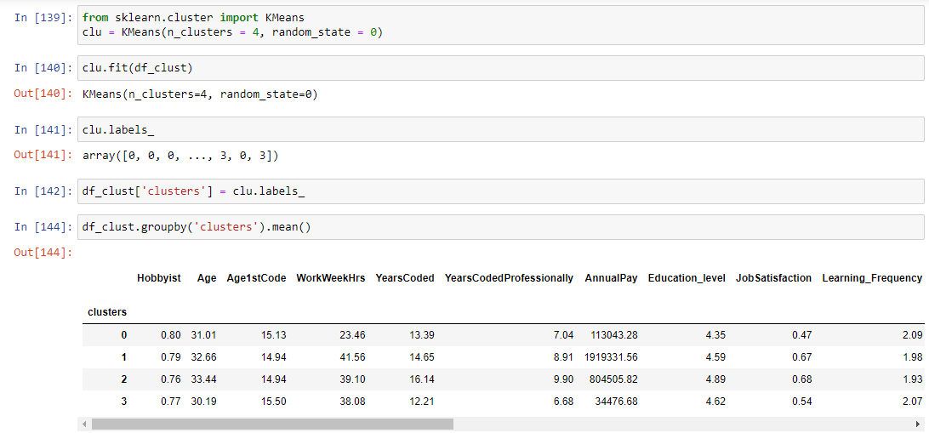
Finding 3 : The need for Better Compensation for Professional Developers

Slide 27
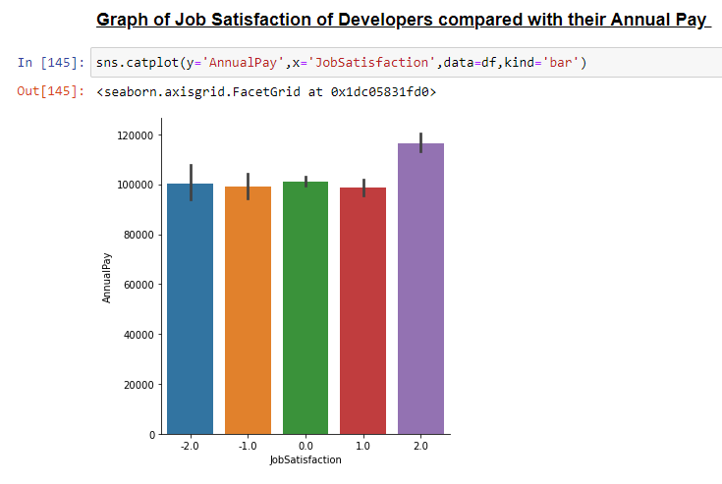
Finding 3 : The need for Better Compensation for Professional Developers

Slide 28
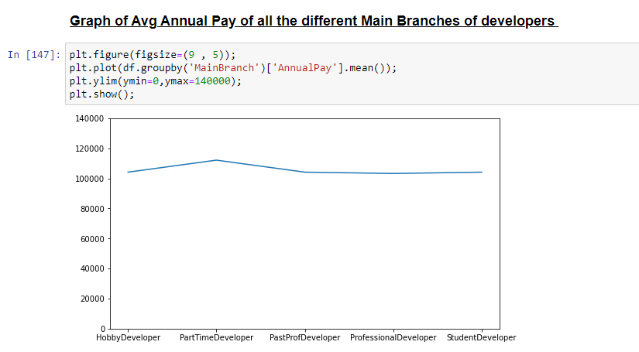
Finding 3 : The need for Better Compensation for Professional Developers

Slide 29
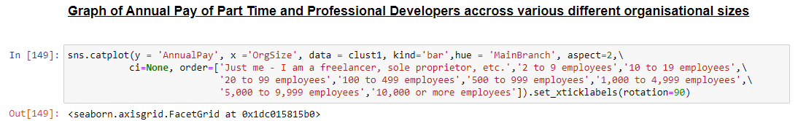
Finding 3 : The need for Better Compensation for Professional Developers

Slide 30
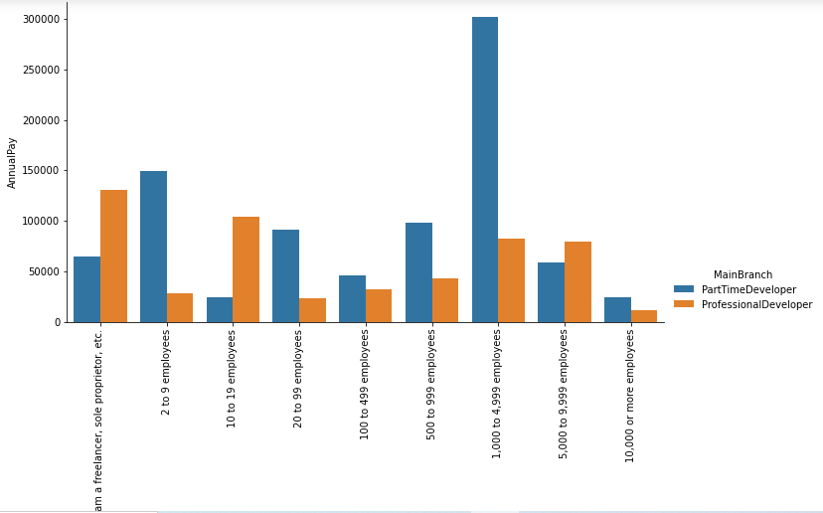
Finding 3 : The need for Better Compensation for Professional Developers

Slide 31
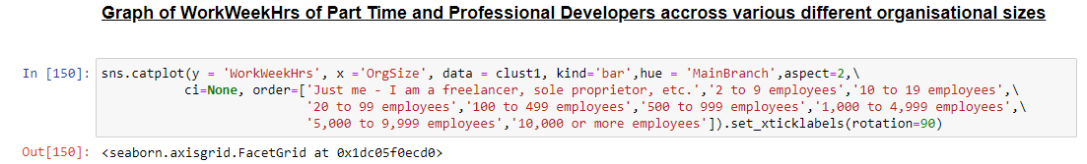
Finding 3 : The need for Better Compensation for Professional Developers

Slide 32
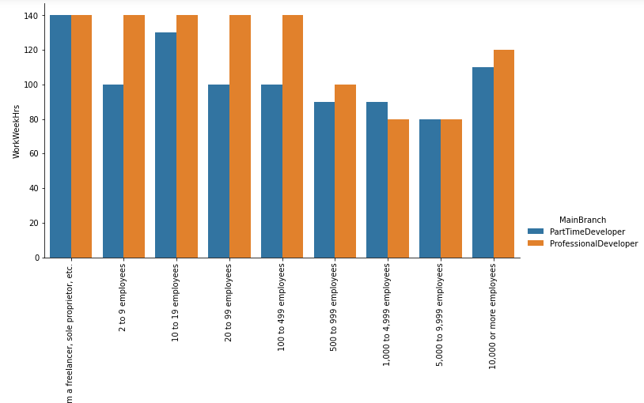
Finding 3 : The need for Better Compensation for Professional Developers

Slide 33
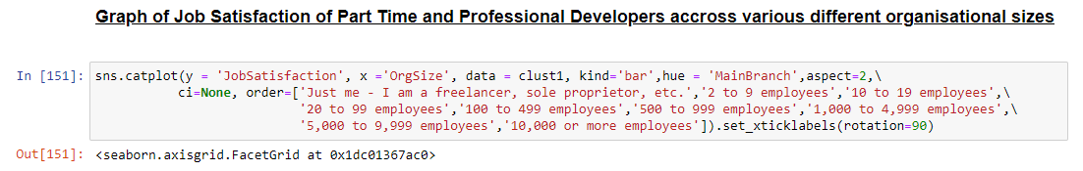
Finding 3 : The need for Better Compensation for Professional Developers

Slide 34
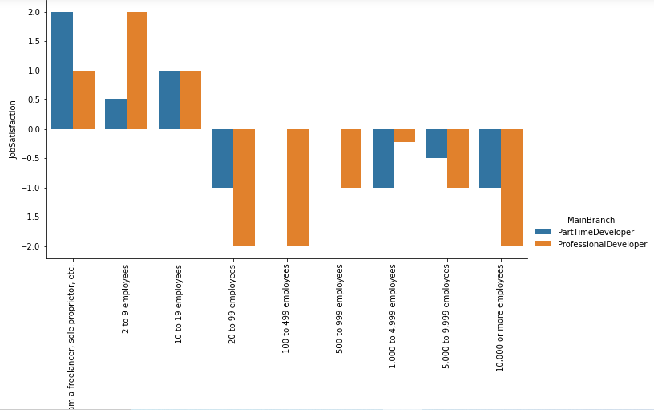
Finding 3 : The need for Better Compensation for Professional Developers

Slide 35
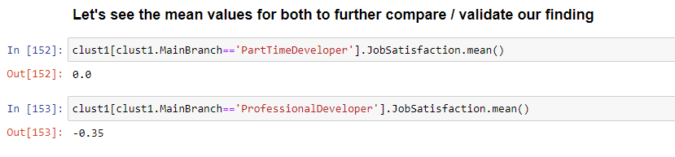
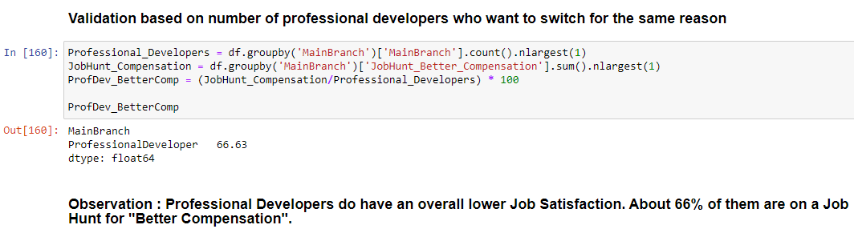
Finding 3 : The need for Better Compensation for Professional Developers

Slide 36
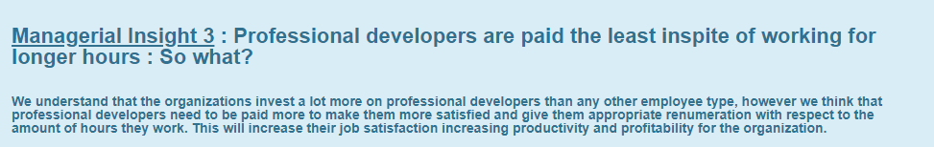
Finding 3 : The need for Better Compensation for Professional Developers

Slide 37
Conclusion
We had a very dry developers survey, but we have come up with some very interesting findings about the industry in general.
Developers Job Satisfaction, treatment of women and also about payment of employees.
Data analysis really does help us get real and useful insights!!

Slide 38
Thank You
Project Group 6:
Pratik Deshmukh Miloni Gada Monisha Gopal Kirtana Kirtivasan Moumi Kumar

